Slide 1

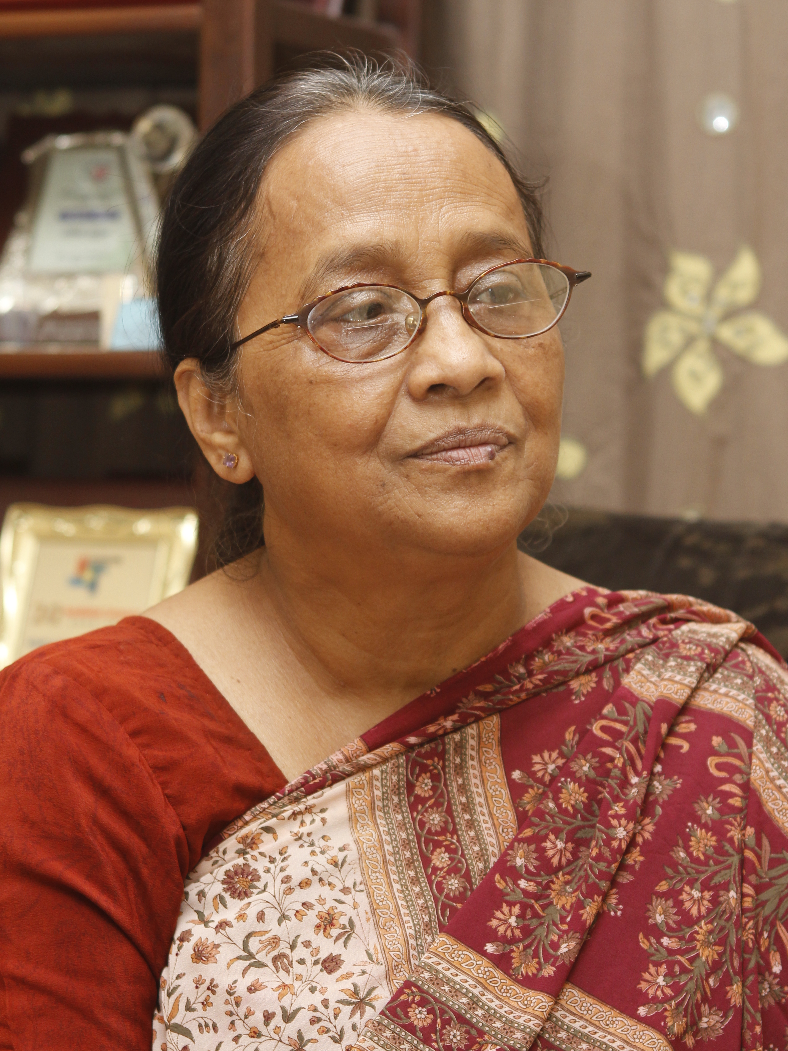
Hangor Nodi Grenade is a novel written by Selina Hossain, a renowned writer of Bangladesh. In 1972, Selina Hossain wrote this story, based on a true incident that occurred at Kaliganj in Jessore during the liberation war. Afterwards, it was published as a novel in the year of 1976.

Slide 2
Hangor Nodi Grenade is a novel written by Selina Hossain, a renowned writer of Bangladesh. In 1972, Selina Hossain wrote this story, based on a true incident that occurred at Kaliganj in Jessore during the liberation war. Afterwards, it was published as a novel in the year of 1976.

Slide 3
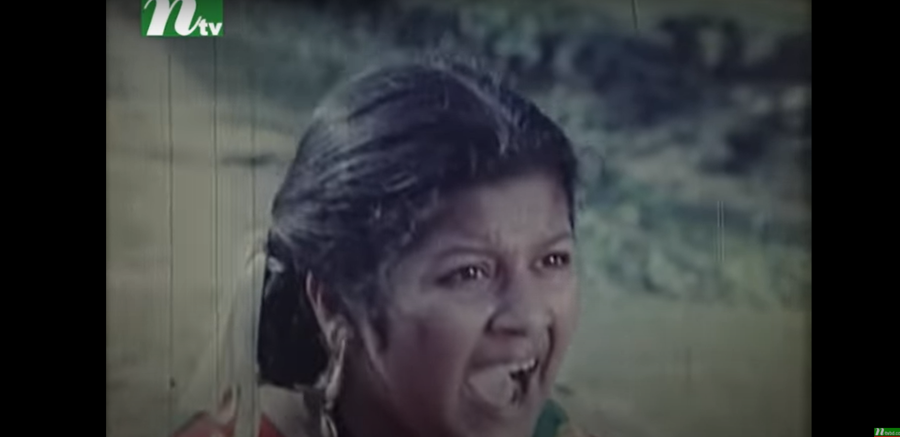
The central character of the Hangor Nodi Grenade is Buri. Buri is the name of a teenager who grew up in a village who doesn't like her name but eventually the name becomes permanent.

Slide 4
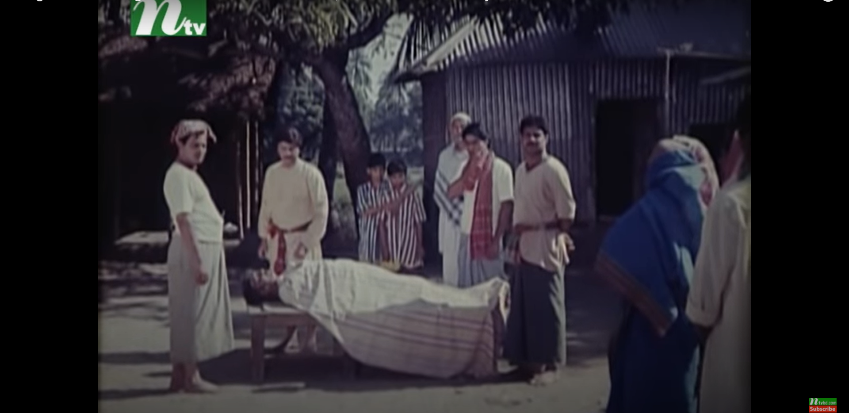
In this way, years passed by and Buri was getting older and her father also passed away.

Slide 5
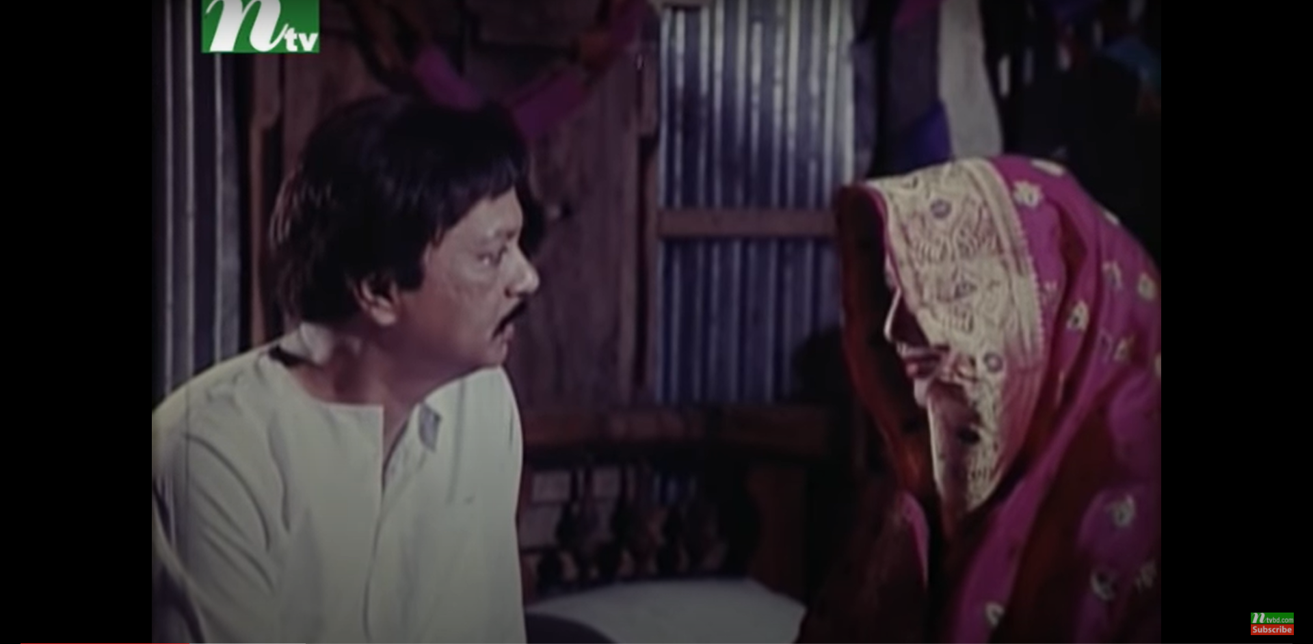
After her father’s death, she got married to her cousin Gafur. Buri was Gafur's second wife! In his family, Gafur had two sons named Saleem and Kalim, left by his ex-wife.

Slide 6
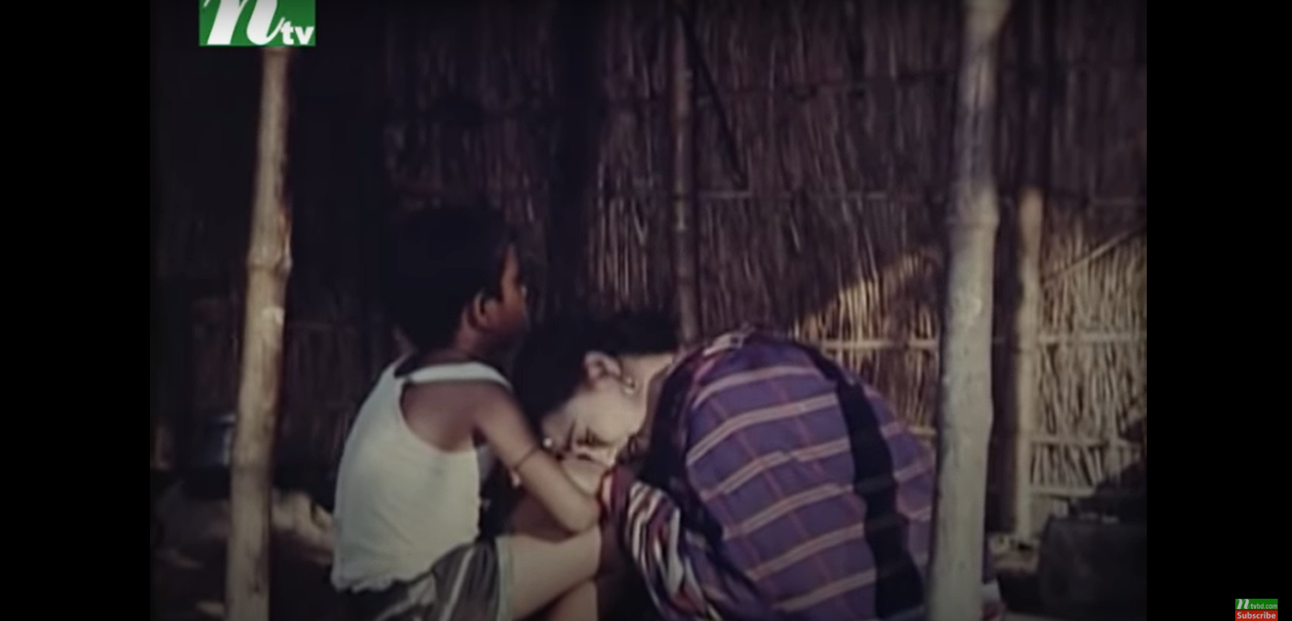
Shortly after their visit, Buri gave birth to their son, Rois.
However, in place of being happy, to her utter surprise, she saw that her dream was shattered as her son was deaf and had trouble of impaired hearing.

Slide 7
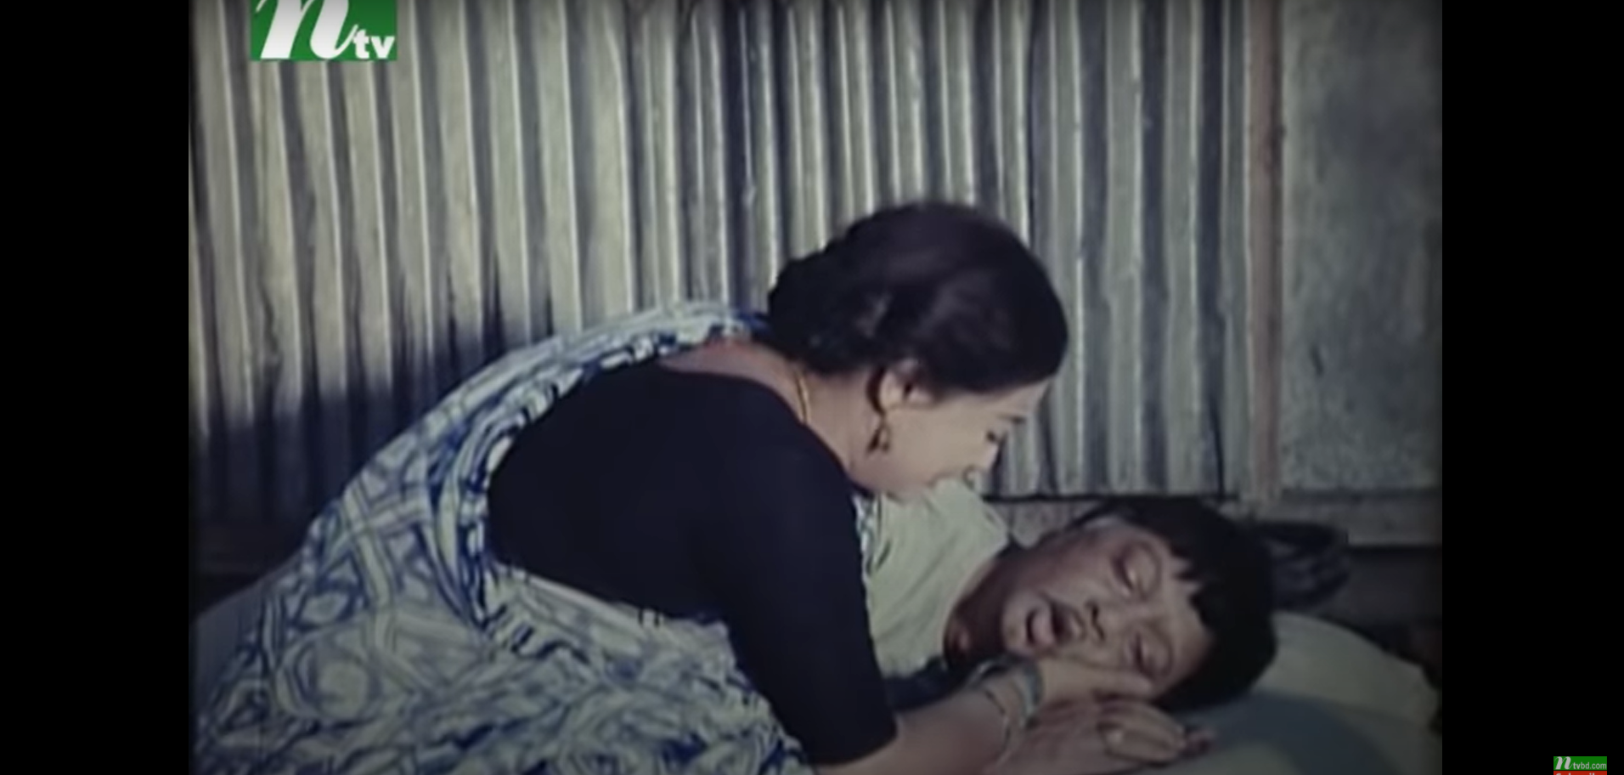
Shortly after their visit, Buri gave birth to their son, Rois.
However, in place of being happy, to her utter surprise, she saw that her dream was shattered as her son was deaf and had trouble of impaired hearing.

Slide 8
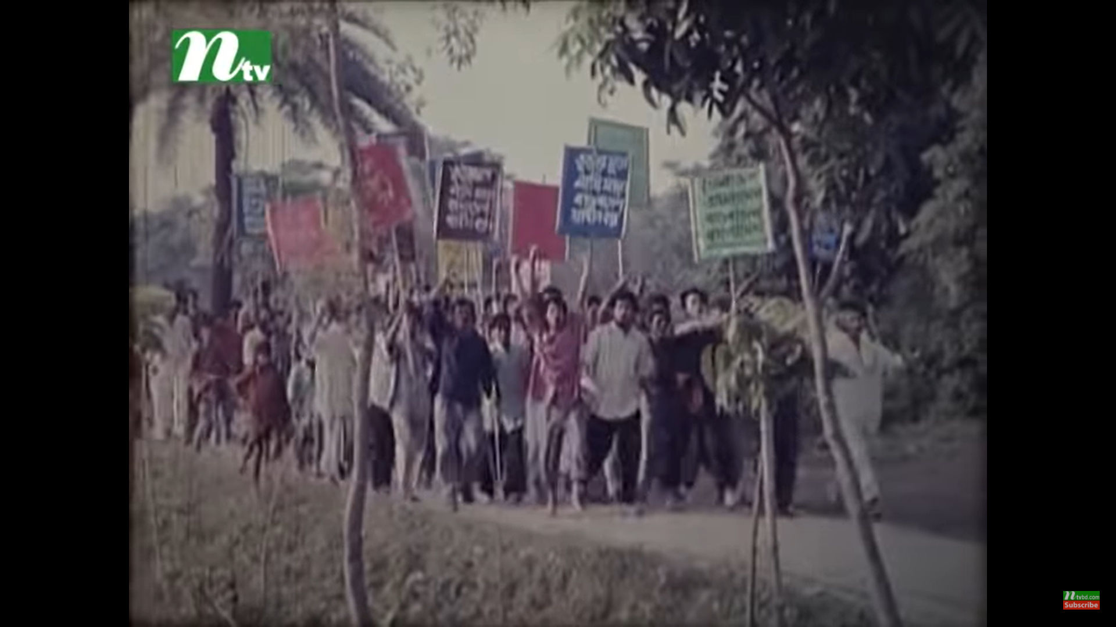
Suddenly the situation in the country started getting worse, rumours were spread that a war would start in the country seeking independence and rights. Buri’s mind was filled with an unknown fear. The village, Holdigaon was also affected.
When the war breaks out, the people of the village had started leaving the village but Buri stayed at her own house. The young boys had also started joining the Mukti Bahini.

Slide 9
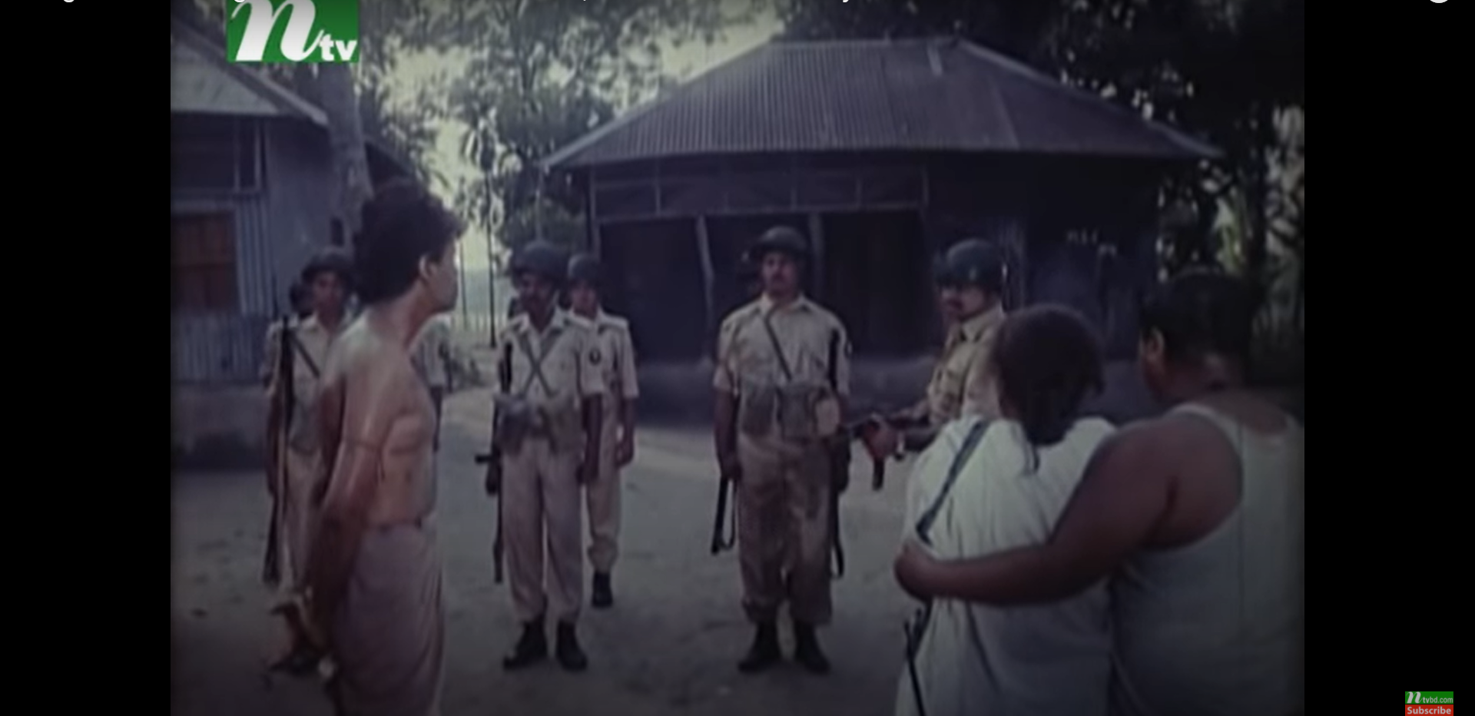
Salim went to war leaving Kalim with the responsibility of the whole family. The Pakistan army came to ask where was Salim. For not informing about Saleem and the Mukti Bahini, Kalim was brutally murdered by the Pakistani Army before the eyes of his mother. Kalim’s death changed Buri’s mind a lot.

Slide 10
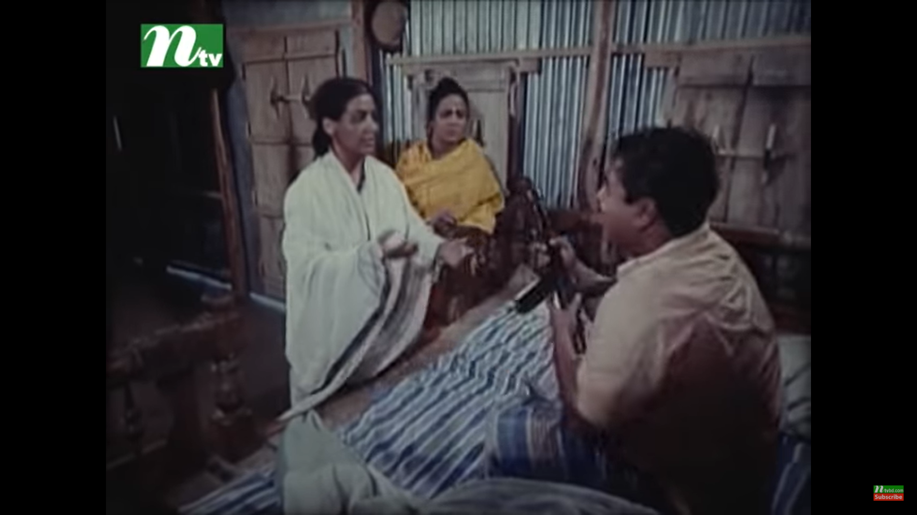
Suddenly, at one night, Hafiz and Kader- sons of Ramjan came across Buri’s house and they wanted to hide in her house to save themselves from the cruel military. Right after that, the invading forces surrounded Buri’s house, she thought these boys must be saved at any cost. Buri handed over an arm to her son Rois

Slide 11
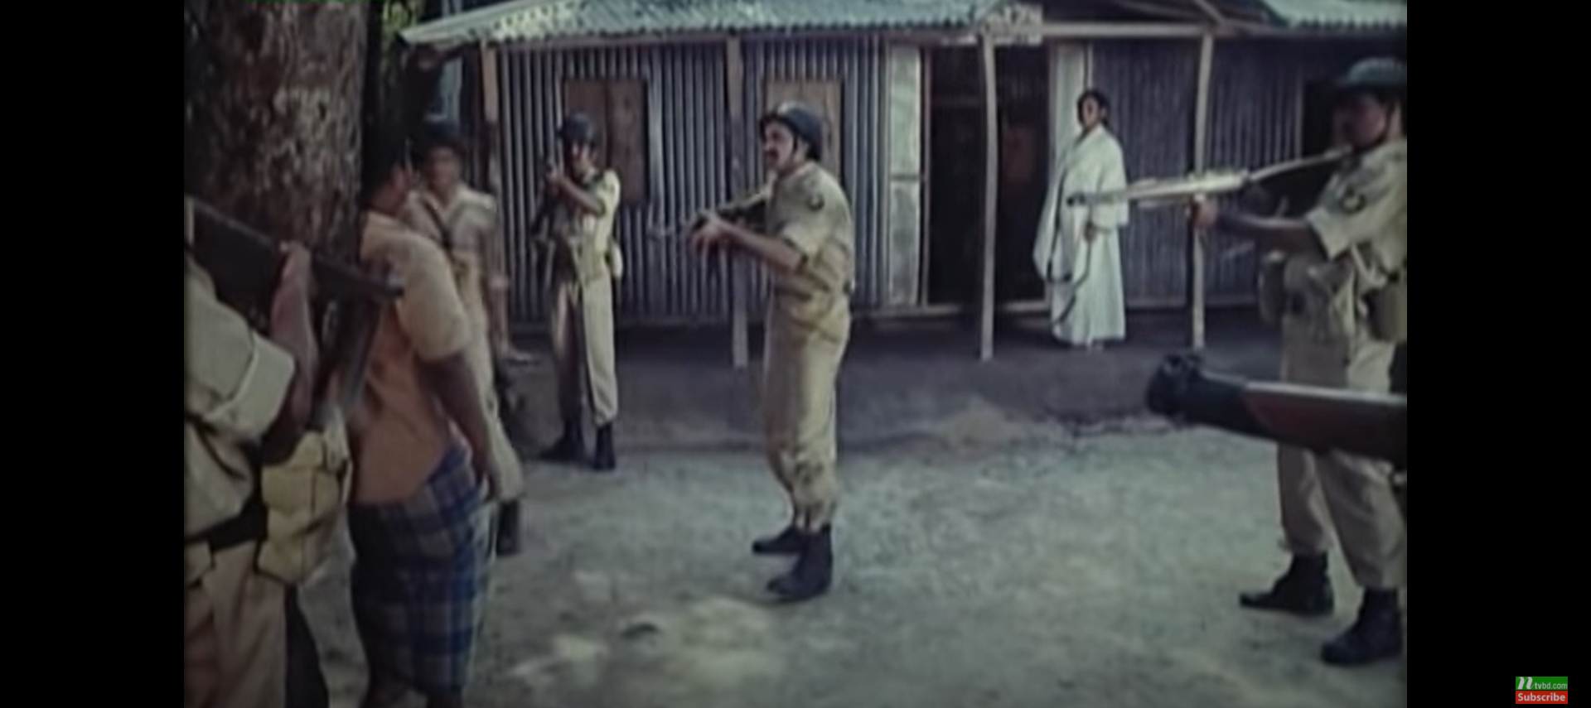
The Pakistany army killed Rois thinking he was a freedom fighter. So she gave up her child to save the two freedom fighters and to put a contribution in bringing our independence.

Slide 12
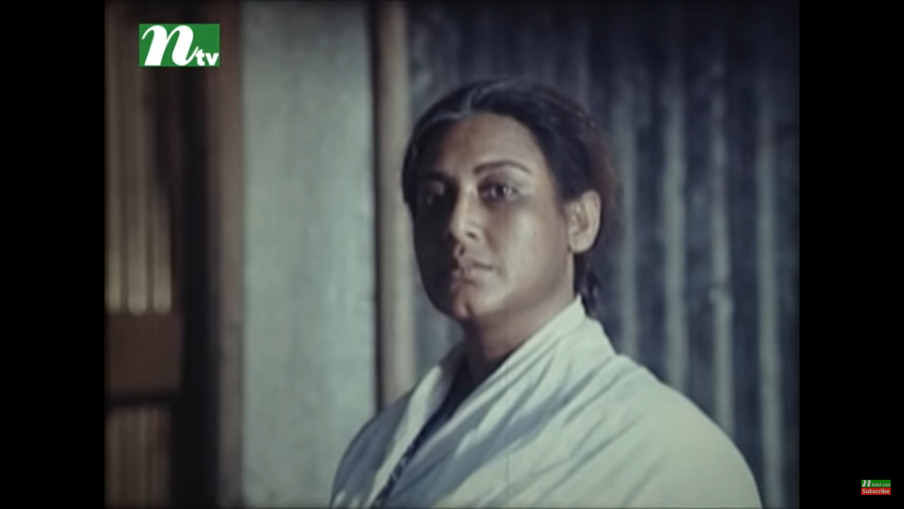
Buri was not the only the mother of Rois but she had become the mother of all freedom fighters.
Thousands of Buri lost their children during the war of liberation. We may don’t know every mother’s sacrifices. Buri sacrificed her child to save two freedom fighters. Such an example of patriotism can never be found again.

Slide 13

Thank You !

